Slide 1
Trial Team Evidence/Advocacy Basics - Experts
Professor Jules Epstein

Slide 2
For the rest of today

Slide 3
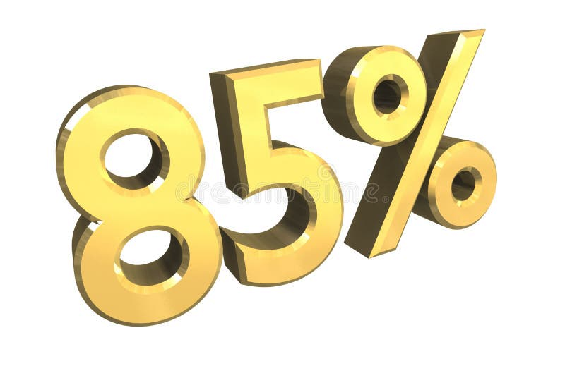
It’s all about

Slide 4
The law part
Qualified (low bar)
Daubert
Sufficient facts/data
Reliable methodology
Methodology applied reliably to the data
Reasonable degree of certainty

Slide 5
The Law Part - 2
Opinion or otherwise
Ultimate Issue
Reliance on hearsay

Slide 6
And in mock trial world?
How much of the expert opinion will be allowed

Slide 7
And in mock trial world

Slide 8
Except
No report, no discovery, going beyond the drafter’s intent

Slide 9
Task 1
Voir dire effectively
Challenge effectively (the “chip away” theory)

Slide 10
Directing The Expert - 1
Intro
Primacy – teaser –
Qualifications
Tendering the expert

Slide 11
The Ritual – Primacy and Qualifications
Q: Please introduce yourself (name and job/profession; maybe “how long have you done this kind of work)
Q: Were you asked [not “hired”] to determine/analyze XXX?
Q: And were you able to determine whether YYY?
TRADITIONAL
Q: Before we get to those findings, the jury is entitled to know your background and training. How long have you been in this field?
MORE INTERESTING
Q: How did you come to be interested in [field]? OR
Q: How long have you been studying and working in this field?

Slide 12
The tender
Offer our expert as broad as possible/appropriate

Slide 13
How about their expert?
Stipulate (stealth game)
Chip away

Slide 14
Challenging Credentials
Missing credentials (ones your expert has?)
Limited practical experience
Improper inflating of credentials

Slide 15
The tender
Listen to their offer
Narrow (then don’t let them go beyond)
Too broad (then object)
No objection
Or
No motion

Slide 16
Now,

Slide 17
Directing the Expert - 2
What did you determine
Thoroughness
Data
Process
Deflect/anticipate attack

Slide 18
Directing the Expert - 3
Testability
Error Rate
Standards
Peer Review

Slide 19
Directing the Expert - 4
Objection proof:
Link the two (or link back to attack)
Where does opposing expert agree with you
What’s wrong with opposing expert
Recency – repeat conclusion
Certainty statement NOTE – THIS CAN GO EARLIER

Slide 20
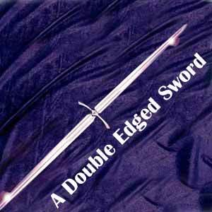
DIRECTING THE EXPERT - 5

Slide 21
One More Thought

Slide 22
What Does That Mean?
The expert becomes the guide
The jury is exposed to the wonders of science

Slide 23
2 THOUGHTS ABOUT PRESENTATION

Slide 24
NOW, CROSS-EXAMINE: A topics checklist - 1
Validate your expert’s credentials
Validate your expert’s methodology
Validate your expert’s sources/data

Slide 25
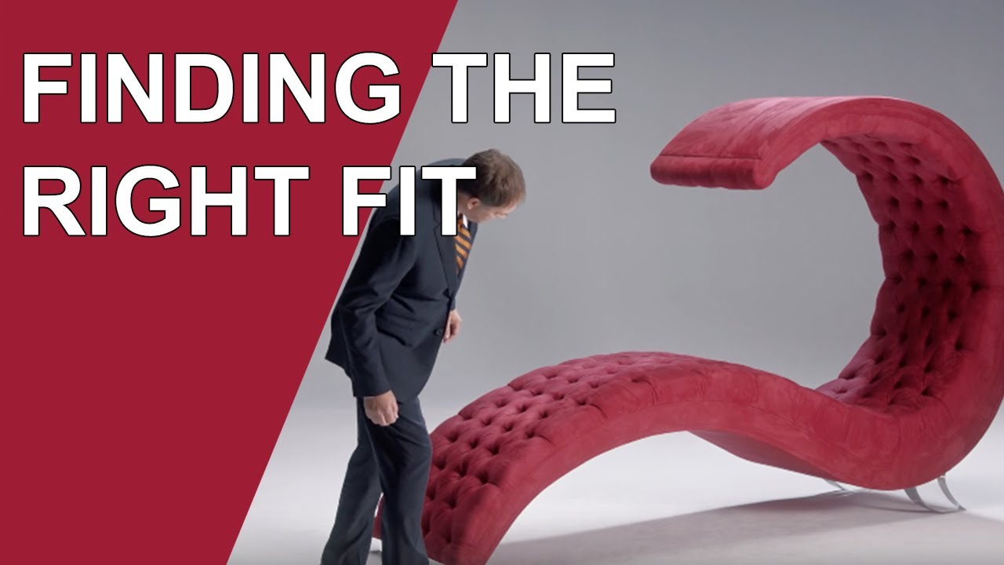
CAN WE AGREE… A topics checklist - 2
An expert should be
Precise
Careful
Consider all the possibilities
Never overstate
If an expert makes an assumption and that turns out to be wrong, their opinion might have to change

Slide 26
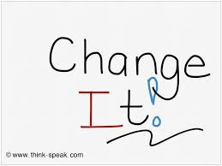
NOW, CROSS-EXAMINE: A topics checklist - 3
The danger of assumptions
Assumptions expert made
If assumptions are wrong, opinion is wrong

Slide 27
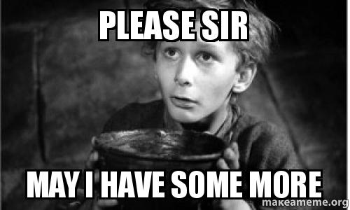
NOW, CROSS-EXAMINE: A topics checklist - 4
The “more factor”
More data would have been better
More tests would have been better
And add the “and you didn’t” questions

Slide 28
One way to highlight the failure to do more
I’m sure that, as a careful expert, you went to the accident scene.
Well. I’m sure as the careful expert that you interviewed the witnesses.
I’m sure…

Slide 29
NOW, CROSS-EXAMINE: A topics checklist - 5

Slide 30
NOW, CROSS-EXAMINE: A topics checklist - 6
The limits of the conclusion
What it doesn’t show
What it can’t answer
The link to your story

Slide 31
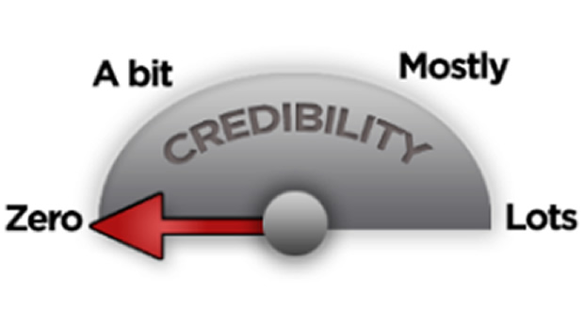
NOW, CROSS-EXAMINE: A topics checklist - 6
Maybe weak – both experts get paid
BUT
Sometimes pay versus hours are outrageous
Bias - $
Bias – one-sided
Bias – biasing information
Traditional impeachment

Slide 32
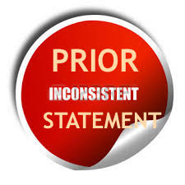
NOW, CROSS-EXAMINE: A topics checklist - 7
testimony

Slide 33
And what to listen for?

Slide 34
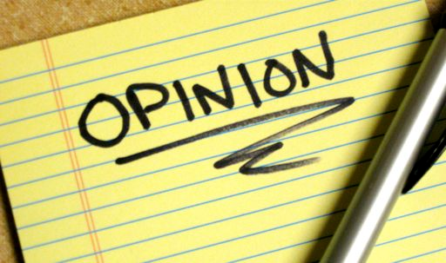
Before we end

